Slide 1
2024
Notes:
Welcome! It is great to be back up here in front of you all, for the first APCM in the Church, since the end of phase 1 of ROCK.
Believe it or not, this is now my seventh APCM Treasurer’s presentation!
Thank you to Jo for teeing me up this morning with your mention of surpluses and deficits! I hope we are all in the mood to hear about our finances!

Slide 2
Notes:
Whilst sat at my desk over the last few of days writing this presentation, I felt called to the word “change”.
Since I was last in front of you, a lot of things have changed:

Slide 3
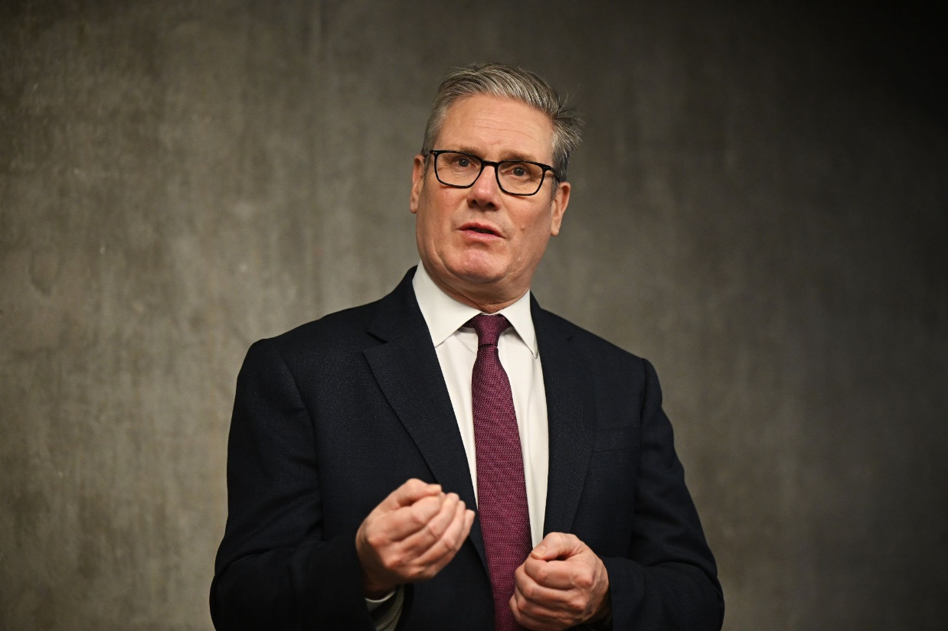
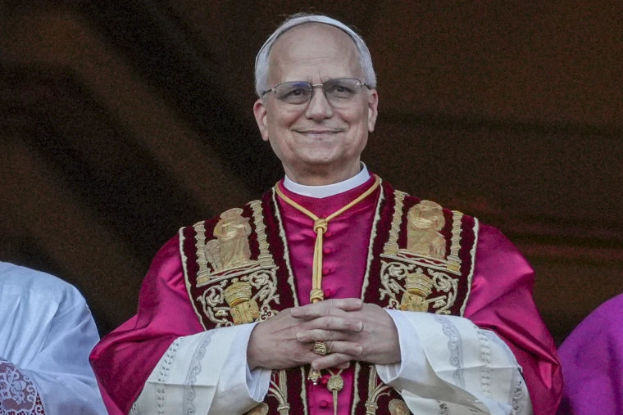
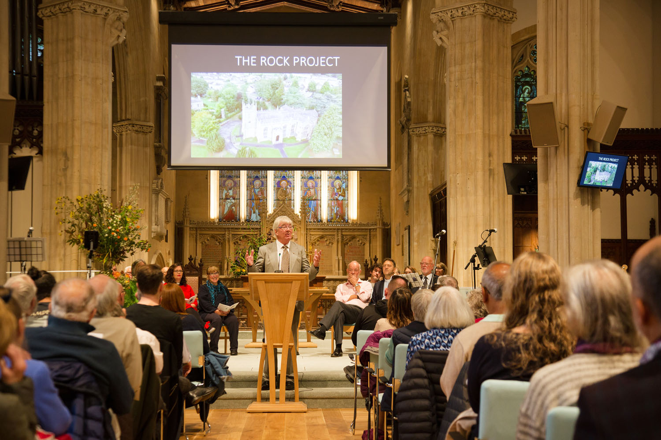
Notes:
We have had a new Prime Minister, new US President, new Pope – I was going to go for a new Archbishop of Canterbury, but it turns out the Catholics are much faster than us at appointing a new leader! – Newly renovated church…

Slide 4
Notes:
And some things never change

Slide 5
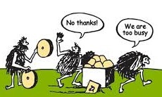
Notes:
Sometimes change is good for us…

Slide 6
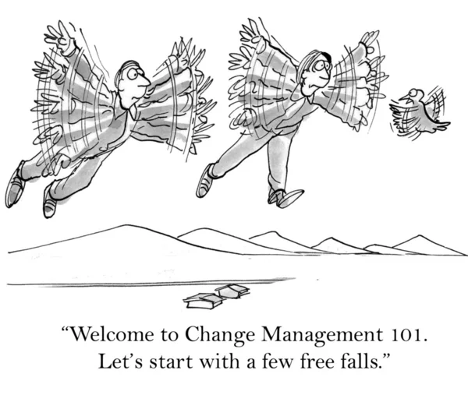
Notes:
And sometimes change is bad for us…

Slide 7
Notes:
Sometimes, we don’t even notice change…

Slide 8
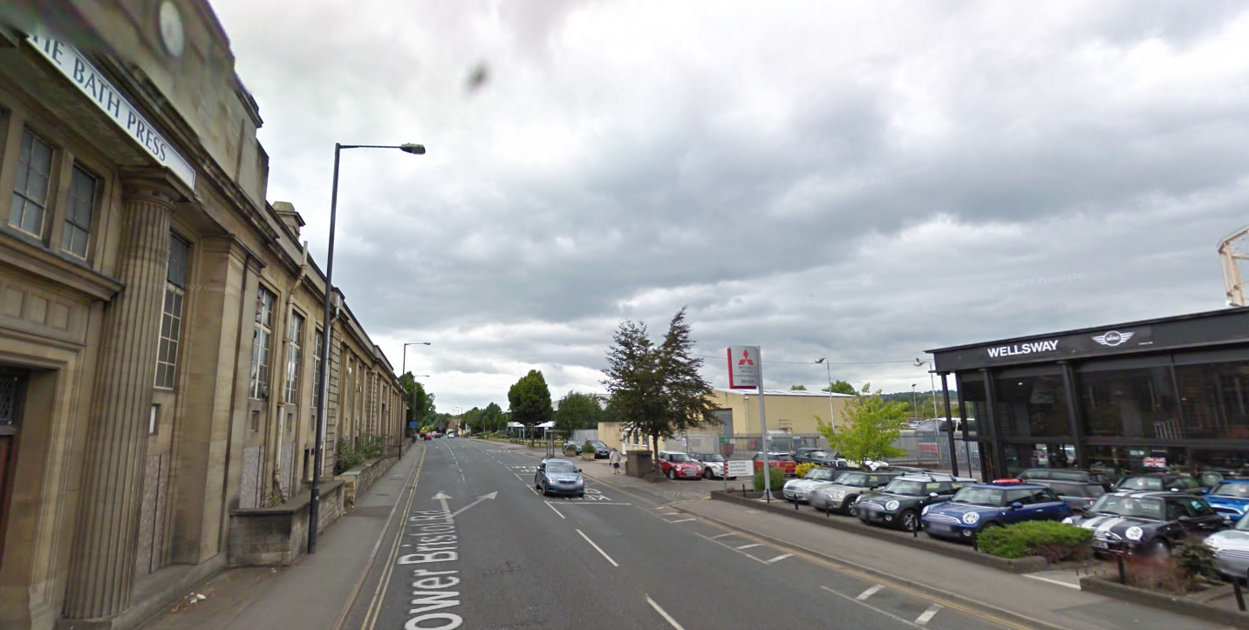
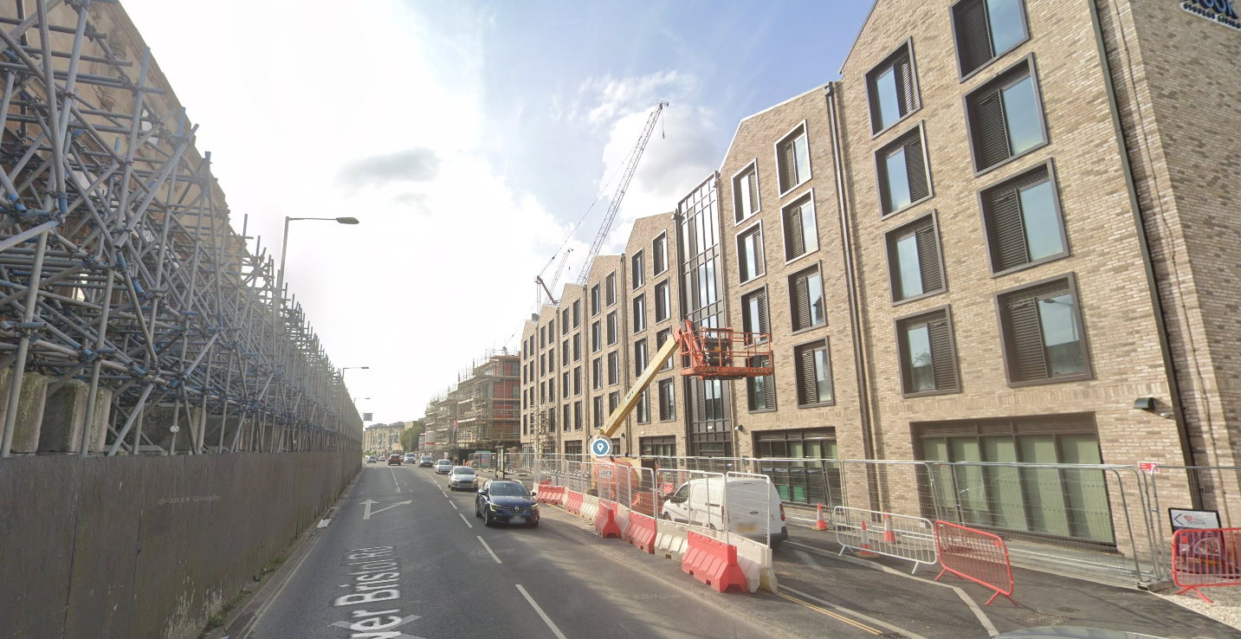
Notes:
And sometimes it is very obvious!
So, what has changed?

Slide 9
Income
Projected
Notes:
You can see that 2024 was our highest year for income over the last decade and was just over 50% higher than 2023. In fact, it was so high, that it nearly caused us a problem. The reporting regulations for charities dictate that, if you have income of more than £1m, you have to have your accounts audited. Our accountants quoted to us that this would cost over £14k. However, I am delighted to say that we received the news late on Friday that we have been given an exemption from the audit. Hallelujah!
Back to our income; there are some things to note with on our income:
Over half our income was restricted, which almost entirely related to ROCK.
Of our Unrestricted Income; about half was from giving, a quarter came from the Scouts returning the Hall to us and the remaining quarter from commercial and investment income.
The completion of this phase of ROCK, explains why our projected income for 2025 is so much lower.

Slide 10
Notes:
What hasn’t really changed?

Slide 11
Unrestricted Giving
Projected
Notes:
Approximately 50% of our unrestricted income in 2024 came from your donations.
As you can see, this has been lower over recent years, from the peak of 2019, and the uptick in 2023 did not continue through into 2024. This was because this uptick was largely as a result of a large one-off donation towards the end of year, following an appeal.
I noted last year that the 2023 donations from Standing Orders and Bank Transfers was the highest it had ever been, beating the previous peak in 2022 by over £20,000. We didn’t quite reach these dizzy heights in 2024, but we were about halfway between the two.
We also set ourselves a budget which was £12,000 higher than 2023 and we managed to get to within nearly £1,000.
Whilst on the face of it this seems like good news, the reality is the events of the last 5 years have meant that our overall giving levels have not reached back to the heights of 2019, let alone kept up with inflation since then.
Indeed, as you might be able to see from the graph, there have only been two years in the last decade when our Unrestricted Giving income has been lower than it was in 2024 (2017 and 2022) and we were £13k under the average.

Slide 12
Unrestricted Giving
Projected
Notes:
If Unrestricted Giving had kept pace with inflation from the peak of 2019, this would have meant that in 2024, we would likely be nearly a third higher than where we ended up.
This year we have set ourselves a budget of just over £348k, which is pretty much the same as our income in 2019. However, this budget assumes that we will receive approximately the same giving as 2024, plus a legacy of over £60k (which incidentally arrived earlier this week). Whilst this legacy was, praise the Lord, even slightly higher than we anticipated, it is a one off and we still find ourselves well short of where we need to be from the pressures of inflation.

Slide 13
Restricted Giving
Projected
Notes:
2024 was, understandably, a record-breaking year for restricted income, coming in at just under £600,000.
Approximately two-thirds of this income was from grants and about one-third was from regular donations.
As you might expect, 96% of all our restricted income related to the ROCK project. Now that this has been completed, you can see that our projected restricted income is much lower (in fact, it is projected to be less than 10% of 2024).
However, we do need to keep in mind that we still owe Methodist Chapel Aid £187,500 plus interest. Our current cashflow model projection for 2025 estimates that only half of our restricted income will be for ROCK, which is a drop of nearly 85% on 2024.
For the first three months of 2025, we have seen a 10% increase in Unrestricted Giving compared to the same time period in 2024. So, it maybe that some of this large drop in ROCK giving is coming across to bolster our Unrestricted Giving income. It would undoubtedly be brilliant if this can continue for the rest of the year.

Slide 14
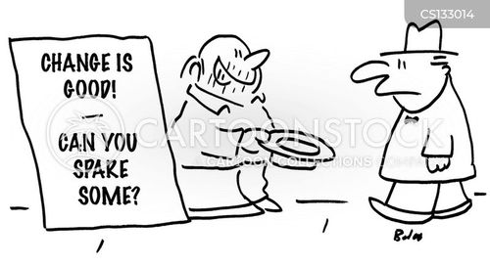
Notes:
It is worth noting that if only 65% of this drop in ROCK giving was redirected to Unrestricted Giving, we would be back on an inflation adjusted income level. So, for all those of you have recently stopped your ROCK giving, we would really appreciate it if you could please bear this in mind.
That being said, I must say a heart-felt thank you to you all for your donations. Anything and everything you give is massively appreciated.

Slide 15
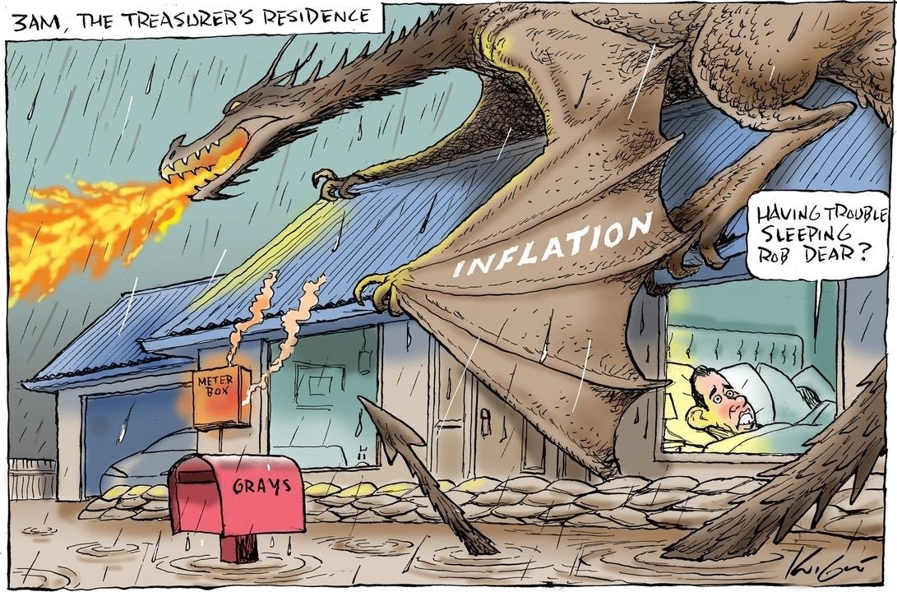
Notes:
Just like last year, inflation remains a big issue for us all and the expenses part of the Church finances are no exception to this.

Slide 16
Expenditure
Projected
Notes:
As you can see, last year was even more unusually high for spending. However, on the plus side, this was around £200,000 less than we anticipated.
Obviously, this is largely due to ROCK, which you can see takes up 70% of the bar. The problem with this is that it is so large, it makes it that much more difficult to determine what has actually happened with everything else.

Slide 17
Expenditure
Projected
Notes:
So, in this graph, I have removed Capital Projects expenditure.
You can see that our expenses did drop down after 2019, as a result of COVID. However, since the low of 2021, they have rapidly increased and are now nearly a third higher than 2021 and 12% higher than 2019.
Of particular note in 2024:
Our Staff Costs were nearly 20% higher than last year (which was also partly due to taking on more staff and partly due to another large increase in the National Minimum Wage);
Our direct activity costs increased by nearly 10%;
There was an increase in Parish Share of 5.5%, after the adjustment for the Benefice Ministry Allowance.
Overall, our costs increased by more than 11.5% last year.
The team has worked very hard to set a budget for 2025 which is slightly lower than our 2024 spend. However, hitting this budget is going to be a challenge, particularly with the rises in energy prices, National Insurance, National Minimum Wage etc. For example, in the first 4 months of this year, we have been charged more than 61% of our annual budget for gas and electricity. I appreciate that these are predominantly winter months, but we do live in England. So, who knows how the rest of the year will pan out!

Slide 18
Expenditure 2024
Notes:
For those of you who are now getting fed up with bar charts, I have included an obligatory pie chart.
I am sorry that it appears to have inadvertently turned into PacMan, it’s just the way it worked out!

Slide 19
Income vs Payments
Projected
Notes:
Back to bar charts!
As has been the way in recent years, the comparison of overall income and expenditure is largely distorted by ROCK, with last year being by far the largest.
However, at least with this graph, you can see how things have progressed over the last 10 years.

Slide 20
2024 Income vs Payments
Notes:
That’s better! Here I have separated ROCK out from everything else.
We can see that ROCK expenditure was more than double ROCK income in 2024. However, we were expecting the expenditure to be high, which is why we were fundraising over recent years.
When removing ROCK, we can see that the rest of our income was slightly higher than our expenditure.
However, as I mentioned at the beginning of my talk, this also included receiving £145,000 from the Scouts for receiving the Hall back (some of which we have already had to spend).
When we only look at the core unrestricted elements of our income and expenditure, we ended up with a deficit of just under £20,500 for the year, which we had to cover from our reserves.
In addition to this, there was around £10,000 of other Capital Expenditure, which has meant that our reserves have now dropped from nearly £102k to just under £69k. This is a significant move away from the three months of expenditure target, which now stands at £108k.

Slide 21
Bank Balance
Notes:
Our cash balances hit nearly £820,000 at the end of 2022. However, from the work on the ROCK project, this dropped to just over £756,000 in 2023 and is now down to just under £333k.

Slide 22
The Split
Notes:
Our Restricted funds had a high of £680,000 in 2022. In 2023, they dropped to £583,500 and by the end of 2024, they stood at just under negative £48k owing to ROCK expenditure (although this negative balance is offset by our MCA loan).
Between the net MCA loan, the Scout Hall funds and our core deficit, our unrestricted funds managed to increase by £207k in 2024. However, of our now £380k unrestricted funds, £311k is designated and 99% of this is the loan and the Scout Hall funds.

Slide 23
Net Current Assets 31 December 2024
Total - £332,714
Notes:
So, to give you a final breakdown of our cash assets, I have another pie chart!
Of the total of £332,714:
£54k is ROCK money being the net of the ROCK deficit and the loan (down from £587k)
£54.4k is Capital Projects (down from £66.7k)
Only £14.5k is our Contingency Fund (down from £35k)
The bequests remained £70.5k
We have just over £6.5k in the Millennium fund (down from £7k last year)
Just over £1k for senior workers; and (down from just under £2k last year)
About £4.5k across other minor pots (down from £8.3k last year).

Slide 24
Notes:
So, where does this leave us moving forward?

Slide 25
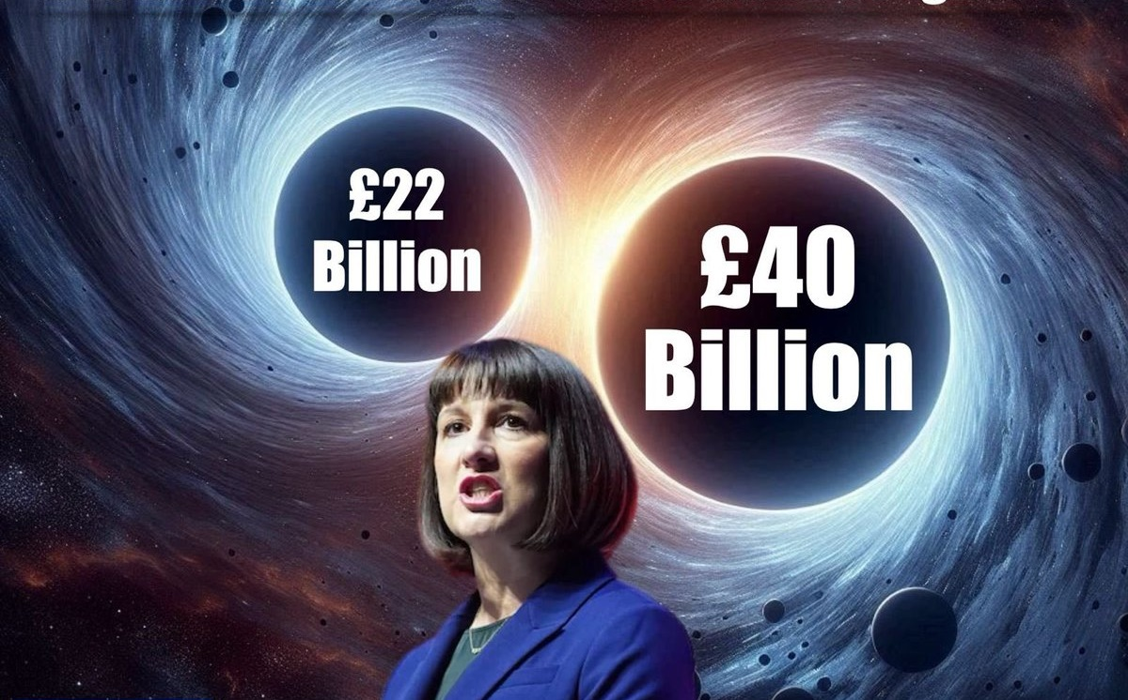
Notes:
There has been more than enough talk of financial black holes over the course of this year, but I cannot shy away from the ever-increasing problem that inflation is imposing on us.
In 2024, we finished the year with a deficit of over £20,000, dropping our contingency to less than £69k. Despite this, the PCC has agreed a balanced budget for 2025; but this is only because of the large legacy we have received. Even then, this will be a challenge to meet, but we have to believe that it’s achievable.
This will depend to a significant degree upon whether we can reach, and preferably exceed, the same level of Unrestricted Income as last year.
2026 will undoubtedly present a further challenge to balance the budget, let alone start to replenish our now depleted reserves.
Our tentative preliminary budget for 2026 indicates that, if we are going to have a chance of even breaking even, we will need to make changes on our expenditure side and see a substantial increase to our income. Whilst we are looking to try and raise some of this income on the commercial side, we will need to see an increase of over 7% to our giving, from what he have budgeted this year (not including the legacy).
Over the last couple of years, around two-thirds of regular givers have not changed their standing orders. Accordingly, I currently have real concern as to whether we can achieve this. So, I come back to my word for the talk of “change”. We all need to go away and prayerfully consider how we can contribute to positively changing the income for our Church; otherwise, we will have no choice but to implement negative changes, by making cuts to what we spend our money on and the things we do.
Therefore, we will continue to need your full support, in order to be able to maintain the various different aspects of our Church, its mission in the community and beyond. We would also appreciate your prayers for wisdom in our stewardship, as we navigate this difficult financial time.
I look forward to seeing you all again soon for the next financial update, at which time I hope I gave some more positive news. However, please come and find me if you have any questions in the meantime.
Thank you all for your time.

